Slide 1

Bank Card Management System
Implementation of Core Data Structures & Algorithms
Key Components:
Linked Lists, BST/AVL Trees, Heaps
Hash Tables (Open Addressing & Chaining)
Graph Algorithms (Dijkstra, Prim's, Kruskal's)
Sorting Algorithms (Bubble, Selection, Insertion, Merge)

Slide 2
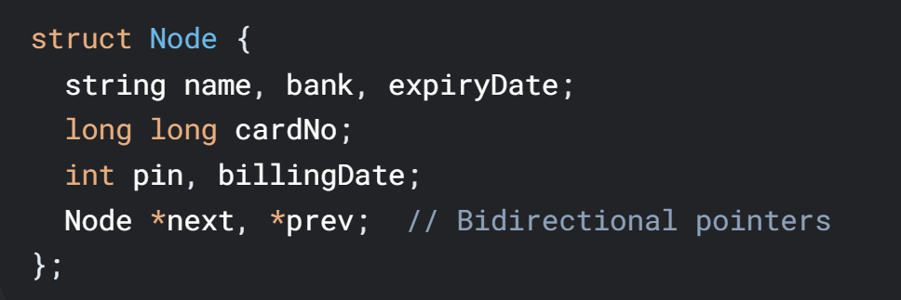
Doubly Linked List
Structure:
Operations: 1- addNode() 2- Insert at tail (O(1)) removeUser() 3-Delete by cardNo + print()
4- Traverse entire list
Usage: Core data container built from CSV input Supports history tracking via stack

Slide 3
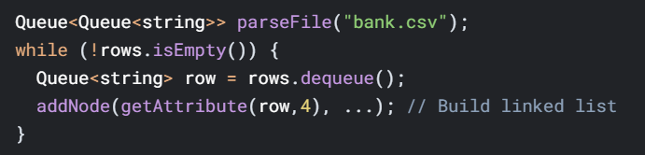
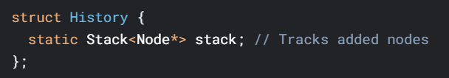
Utility Systems
CSV Parser:
History Stack:

Slide 4
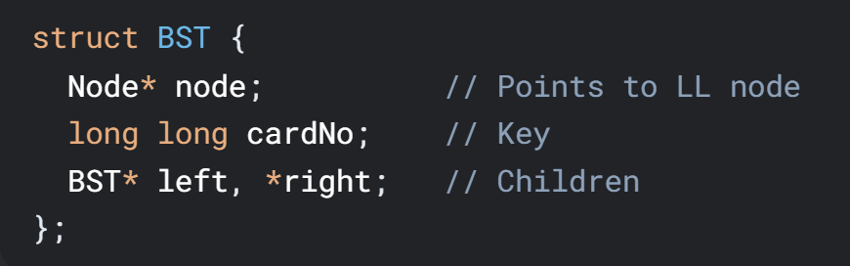
Binary Search Tree (BST)
Purpose: Efficient card number search
Structure:
Operations: 1- insertBST(), 2- Recursive insertion (O(h)) 3- searchBST() 4- Binary search (O(log n) avg)
Usage: Menu Option 7: Fast card number lookup

Slide 5
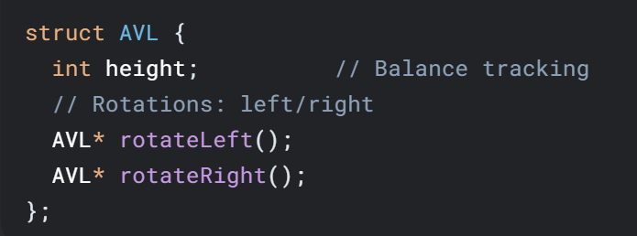
AVL Tree
Purpose: Self-balancing BST for worst-case O(log n) searches
Key Mechanics:
Rebalancing Cases:
LL/RR rotations for left/right imbalances
LR/RL rotations for zig-zag cases
Usage:
Menu Option 8: Guaranteed fast search

Slide 6
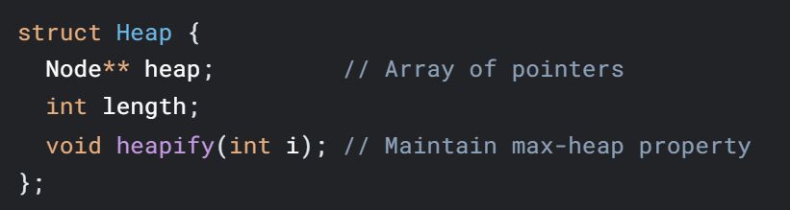
Heap (Priority Queue)
Purpose: Extract card with maximum number
Structure:
Operations: 1- extractMax() 2- Remove root + reheapify (O(log n))
Usage: Menu Option 9: Find highest card number

Slide 7
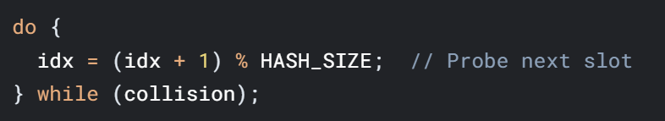
Hash Tables
Collision Resolution Strategies:
Open Addressing (Linear Probing)
Purpose: Fast lookup of PIN
Structure:
Usage: Fast lookup of customers by PIN

Slide 8
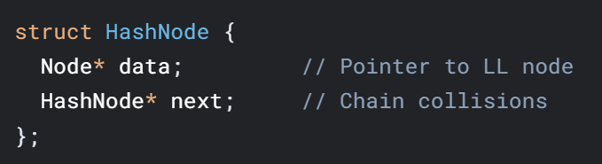
Hash Tables (Cont’d)
Separate chaining:
Purpose: Fast lookup
Structure:
Operations: insertToChainTable(), searchInChain(), dsiplayChainTable()
Usage: Fast lookup of customers by PIN

Slide 9
Hash Tables (Cont’d)
Operations:
searchOpenAddressing() (Option 13)
searchInChain() (Option 14)
Hash Function:

Slide 10
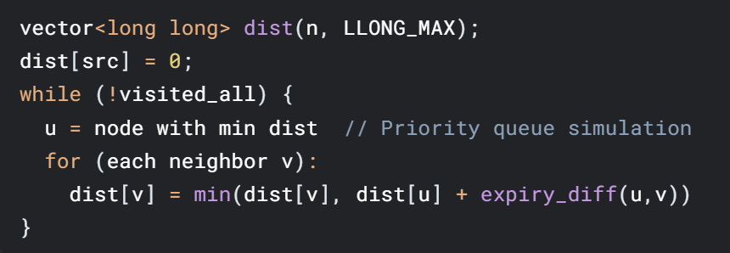
Graph Algorithms
Dijkstra (Option 10):
Purpose: Find users who share similar expiry date
Structure:

Slide 11
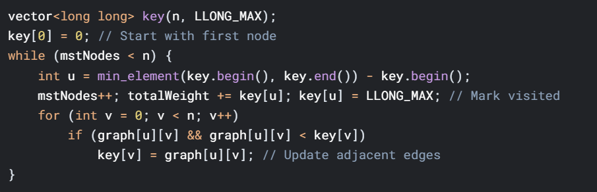
Graphs (Cont’d)
Prims’s algorithm:
Purpose: Find customers with similar billing date
Structure:

Slide 12
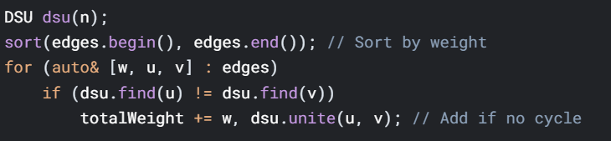
Graphs (Cont’d)
Kruskal’s algorithm:
Purpose: Find the minimum path (MST)
Structure:
Usage: Find customers with similar billing date

Slide 13
Graph Algorithms (Cont’d)
Prim's vs Kruskal's (Options 11-12):
Prim's | Kruskal's
Vertex-based (greedy) | Edge-based (sort + DSU)
O(V^2) | O(E log E)
Uses key[] array | Uses Disjoint Set Union
Same MST weight result | Same MST weight result

Slide 14
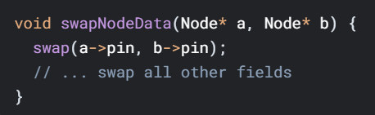
Sorting Algorithms
Pointer-Preserving Sorts:
Algorithm Choices:
Bubble/Selection Sort: Swap node data (Options 17-18)
Insertion/Merge Sort: Rearrange pointers (Options 19-20)
Post-Sort Actions:
Rebuild BST/AVL + hash tables
Option 21: Display sorted list

Slide 15
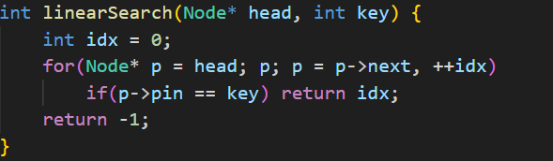
Searching
Linear search (option 24):
Purpose: Classic lookup
Structure:
Usage: Find customer by PIN

Slide 16
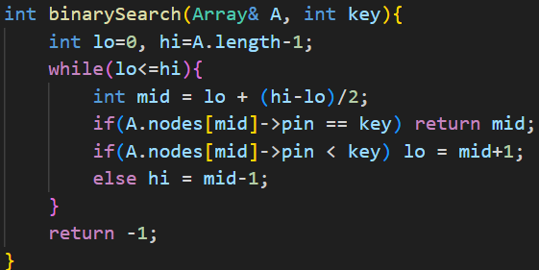
Searching (Cont’d)
Binary Search (option 25):
Purpose: Find customer by key (PIN)
Structure:

Slide 17
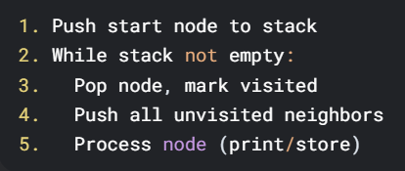
Searching (Cont’d)
Breadth-first search (option 22):
Purpose: find all customers of a bank
Structure:

Slide 18
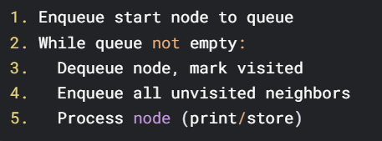
Searching (Cont’d)
Depth-first search (option 23):
Purpose: find all customers of a bank
Structure:

Slide 19
Conclusion
System Strengths:
Multiple search options (BST/AVL/Hash)
Flexible data modification with auto-rebuild
Comprehensive graph/sort algorithms
Areas for Enhancement:
Heap-based priority queue for Dijkstra
Hashing with cryptographic PIN security
Thread-safe operations for concurrent access

Slide 20
End of Presentation
Implemented in C++ | COMSATS University Islamabad

